Slide 1

Project Title
AIRBNB HOTEL BOOKING ANALYSIS
Mohit Cheedala

Slide 2

PROBLEM STATEMENT
Airbnb has changed the way people travel, but in major cities, certain neighborhoods are overcrowded with listings while others remain underutilized. This creates issues like pricing imbalance, inconsistent availability, and uneven guest experiences. Analyzing the dataset can help identify which neighborhoods dominate the market, which room types are most common, and how reviews differ across locations.

Slide 3
Project Description
This project explores Airbnb data to uncover imbalances in listings across neighborhoods and study the relationship between room types, availability, and guest reviews.
Key objectives:
Perform data cleaning and preprocessing.
Analyze distribution of listings by neighborhood group.
Identify top hosts and how they contribute to listing density.
Compare review activity and availability across neighborhoods and room types.
Generate visualizations (bar charts, heatmaps, scatter plots) to highlight overcrowding patterns.

Slide 4

WHO ARE THE END USERS?
Airbnb Management → to balance growth across neighborhoods.
Hosts → to identify competitive markets and optimize listings.
Travelers → to understand popular areas and choose better-value stays.
Urban Planners/Researchers → to study the impact of Airbnb on local housing.

Slide 5

Technology Used
Python (Pandas, NumPy) → Data cleaning and processing.
Matplotlib, Seaborn → Visualizations of listing density and trends.
WordCloud → Text analysis of listing names.
Jupyter/Colab → Development environment.
GitHub → Repository hosting & version control.

Slide 6
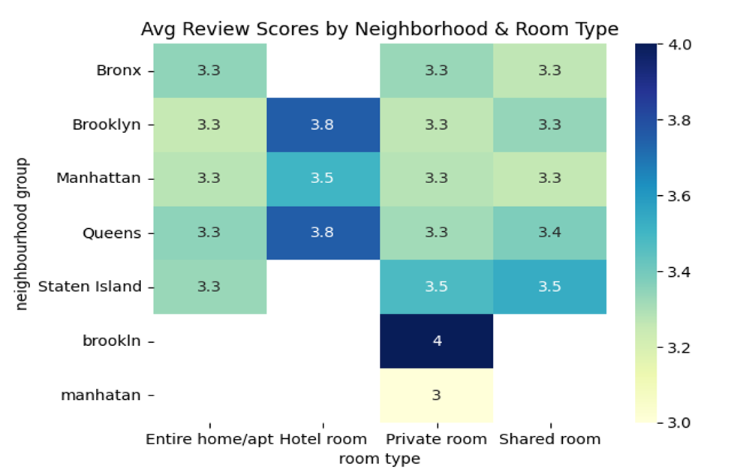
RESULTS 1

Slide 8
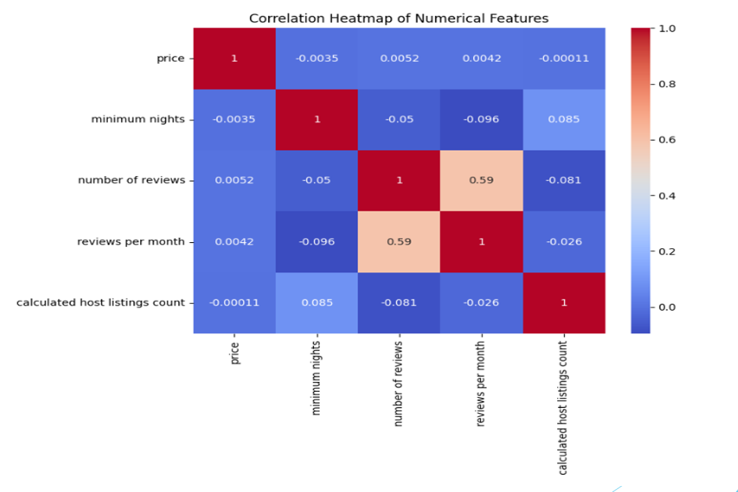
RESULTS 2

Slide 9
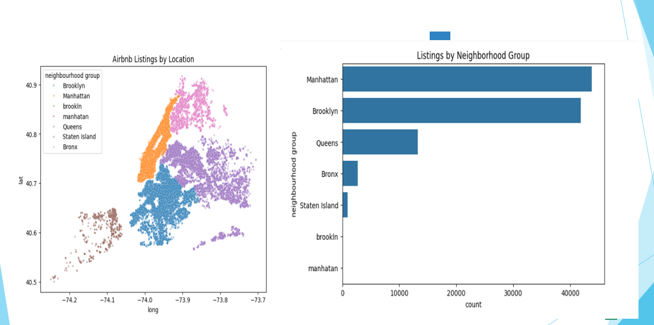
RESULTS 3

Slide 10

Github link : mohit-756/AIRBNB-HOTEL-BOOKING-ANALYSIS
.
.

